Slide 1

Analysis of Aviation Accident Data
Edgar Muturi
Data science phase 1 project

Slide 2
Business Problem
The company is expanding into new industries to diversify its portfolio
Interest- purchasing and operating airplanes for commercial and private enterprises
Problem- lack of knowledge on potential risks of aircraft
Goal of this presentation- determining which aircraft are the lowest risk for the company to start this new endeavor

Slide 3
Method
Analysis of NTSB aviation accident data
Data analyzed using pandas and tableau
Only data from 1990 was considered in order to reflect modern aviation technology
To start with, the makes with the most and least number of accidents since 1990 was established

Slide 4
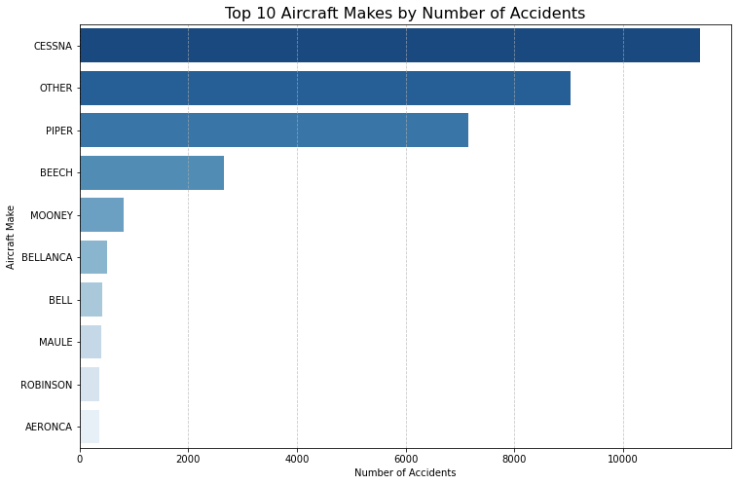
Top 10 Makes by Number of Accidents

Slide 5
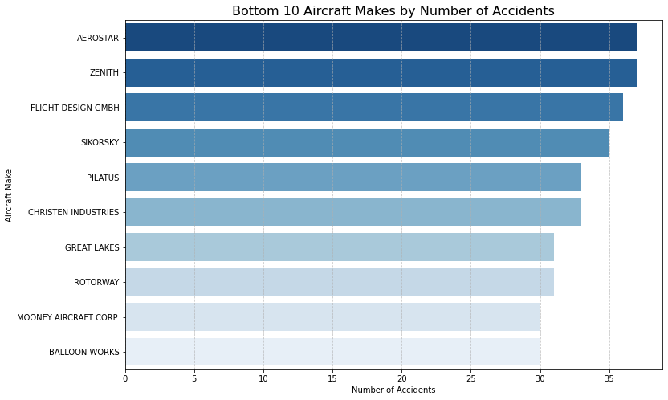
Bottom 10 Makes by Number of Accidents

Slide 6
Bottom 10 Makes by Number of Accidents
From the previous slide, the makes with least accidents are Balloon Works, Mooney Aircraft Corp, Rotorway and Great Lakes

Slide 7
Analysis- Safest Makes by Risk Score
A risk score was developed based on whether victims had fatal injuries, serious injuries or minor injuries
Total fatal injuries were multiplied by 5, serious injuries by 2 and minor injuries by 1. The sum of these three for a particular make constituted the risk score.
A bar chart showing the safest makes by risk score was obtained

Slide 8
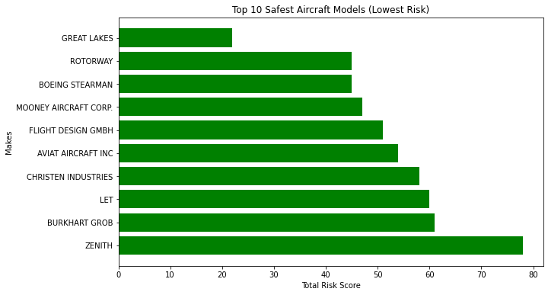
Analysis – Safest Makes by Risk Score

Slide 9
Analysis- Safest Makes by Risk Score
From the previous slide, Great Lakes, Rotorway and Boeing Stearman have the lowest risk scores
This means that in the event of a crash, passengers are at lowest risk when flying with these aircraft makes.

Slide 10
Analysis of Safest Makes by Risk Score
From the chart on the previous slide, the safest makes by risk score are established.
Having found the makes with the lowest risk scores(based on how victims were injured), it is also prudent to analyze how much these aircrafts get damaged when they crash.
A bar plot of aircraft damage for these makes was therefore plotted

Slide 11
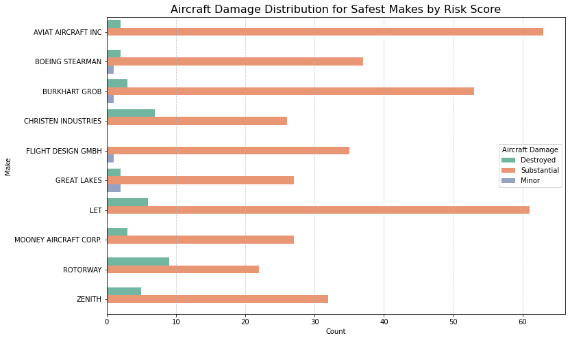
Aircraft Damage Distribution for Safest makes by Risk Score

Slide 12
Aircraft Damage analysis continued
From the previous slide, it is clear that Aviat Aircraft Inc, LET and Burkhart Grob are the aircraft with the highest number of makes with substantial damage following an accident
Rotorway and Christen have the highest number of makes with destroyed aircraft following an accident
Great Lakes has the highest number of makes with minor damage following an accident

Slide 13
Recommendations
From the data, Great Lakes emerges as a great first choice for aircraft to invest in. This is because it has the 4th least number of accidents, safest by risk score and has the highest number of makes with minor damage following an accident.
Rotorway emerges as a potential second choice as it has the 3rd least number of accidents and 2nd safest by risk score. However, it has the highest number of makes destroyed following an accident
Mooney Aircraft Corp is a potential third option as it has the 2nd lowest number of accidents and has the 4th lowest risk score
Summary: Invest in Great Lakes, Rotorway and Mooney Aircraft Corp

